Slide 1
Behavioral Crisis in Individuals with Severe Autism: Understanding the Need
Amanda P. Laprime, Ph.D., BCBA-D
Assistant Professor of Pediatrics
Direction of Intensive Behavior Program
Division of Transitional Care Medicine
Division of Developmental and Behavioral Pediatrics
Department of Pediatrics

Slide 2
Who Am I?
A doctoral level behavior analyst
A faculty at the University of Rochester Medical School
Developed first Intensive Behavior Program
A sister of a man with autism
A passionate advocate for preventing crisis events and supporting those individuals and their families who experience crisis
A person who doesn’t accept being told “No”

Slide 3
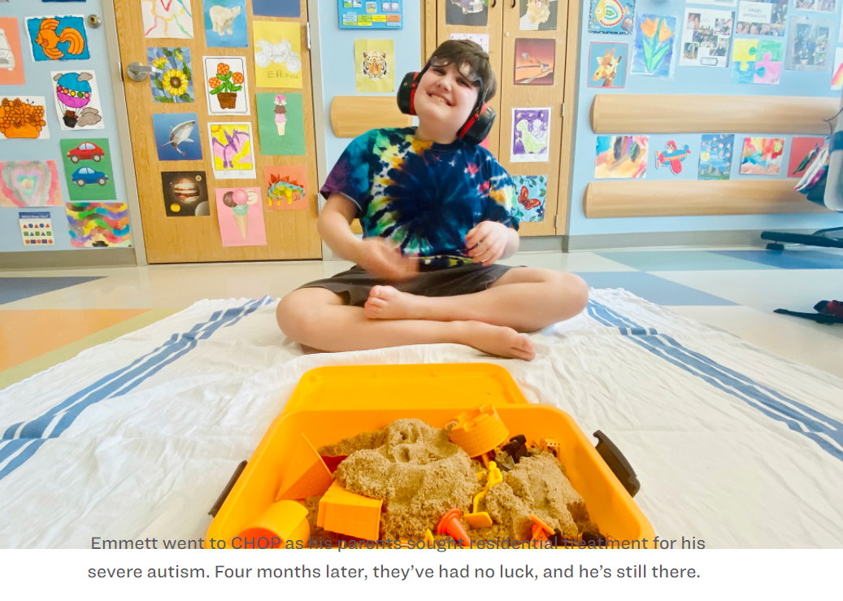
The Issue at Hand

Slide 4
Who?
Children, Adolescents, and Adults with Autism, most of which also have I/DD, who experience a mental health or behavioral health crisis
For today’s talk- the focus will be on those individuals with severe or profound autism
Social, developmental, and cognitive challenges of this subset of the autism population may result in acute crisis events
The caregivers of those individuals already defined

Slide 5
Who Are the Families?
Dedicated advocates for their children
Have sought out experts and expertise locally, nationally, or both
Have tried all the “things” they were told to try
Are looking to ensure their child, themselves, and their family are safe

Slide 6
What is a Crisis?
Crisis, a definition: “a time of intense difficulty, trouble, or danger; a time when a difficult or important decision must be made”

Slide 7
Crisis vs. Emergency
Emergency is defined as “a relatively abrupt sudden situation in which there is an imminent risk of harm”
(1) suicide, (2) physical harm to other, (3) states of seriously impaired judgment in which the individual is endangered or (4) risk to a defenseless victim.
A crisis is a “loss of psychological equilibrium’ and lasts longer than an emergency, but has a decreased risk of danger to self of others than an emergency

Slide 8
Service Options
Vary greatly by state
Generally inclusive of the following (but not limited)
Mobile crisis teams (Both emergency and crisis)
Emergency responders (Emergency)
In-home family support services (Crisis)
Emergency departments (Emergency)
Inpatient programs (Crisis)
Respite (Emergency or Crisis)
Stabilization programs (Crisis)

Slide 9
The Problem
Limited service options compared to the need
The scope of the problem is not well understood
Crisis services fail to address the underlying issues that resulted in the crisis
Lack of integrated, continuum of care models to prevent and address crisis events
Discrepancy and misunderstanding of the etiology of the crisis for those with profound autism
Lack of ongoing, state funded supports to stabilize an individual upon discharge from higher levels of care
Boelter, presentation Autism 200 Series, Seattle Children’s Hospital)

Slide 10
The Problem-Continued
Lack of residential, respite, and other higher level of care options
Shortage of specialized providers
Lack of supports for family members (also experiencing the crisis)
Silo’d and fragmented care
Reduced options as an individual ages, increasing the probability of crisis events
Multiple groups, agencies, stakeholders, advocates trying to solve the issue without working together to define and advocate for the same outcome!

Slide 11
Etiology Challenges
Mental health crisis vs. Behavioral crisis
Emergency services vs. Crisis services
Service system that best supports individual
Treatment for the challenge

Slide 12
Etiology Challenges
“One surprising finding was the large number of children with autism seen in the ER for psychotic disorders. Dr. Vasa, a renown psychiatrist from KKI suspects that this is largely a misdiagnosis. “Individuals with autism can have a psychotic disorder, but we think this is often a misinterpretation of the [individuals] behavior that occurred in the context of the child’s underlying language, cognitive and social impairments,” she says.
Kalb, L.G., Stuart, E.A., Freedman, B., Zablotsky, B & Vasa, R. (2012) Psychiatric-related emergency department visits among children with an autism spectrum disorder. Pediatric Emergency Care. 2012 Dec;28(12):1269-76.

Slide 13
What Options?
Emergency
Crisis
Mobile crisis team
Stabilization program
Intensive outpatient
Intensive in-home
Intensive care coordination
… and others
Emergency responders
Mobile crisis team
Emergency department
Acute inpatient

Slide 14
The Challenges for the Individual & Family
Lack of adequate psychiatric and medical diagnoses and stabilization
Failure to stabilize with intensive behavior support and teaching
Lack of adequate staffing support in the home environment
Services not being available (in-person!) at the moment of the emergency
Owning and telling the story
Fear of community responders and emergency medical settings
Misunderstanding of resources (mental health vs. behavioral intervention)

Slide 15
Defining the Challenge
Understanding the scope of the crisis problem
Defining a full continuum of care for ASD/IDD individuals
Advocating for multi-system support for establishing a continuum of care
Getting feedback from caregivers and providers on how to improve this

Slide 16
The Challenge

Slide 17
The Utility of Crisis Services in Region 1
Survey sent to community caregivers, providers who support individuals with ASD and have utilized crisis services in past year
Survey also sent to known mobile crisis teams, NY Start (CSIDD), and FSS teams
37 respondents

Slide 18
Why Complete Data Analysis?
Stakeholders, funders, governmental agencies, and leadership at the state, national, and community level often fail to understand the gaps between the services provided and the experiences of those who utilize the services
We must look at trends year after year, and articulate how and if current services are or are not addressing these challenges
We must tie the data to social, fiscal, and health equity impact across entities
When we show cost savings, increased health equity, reduction of the “domino effect” we are likely to get long term solutions

Slide 19
Services Available in Region 1
Mobile crisis teams
Psychiatric ED & Inpatient psychiatric programs
Family Support Services
Respite opportunities
Stabilization programs
NY START (CSIDD)
Specialized SW team to respond to Mental Health Crisis with ER
… and many other supports

Slide 20
Population Data

Slide 21
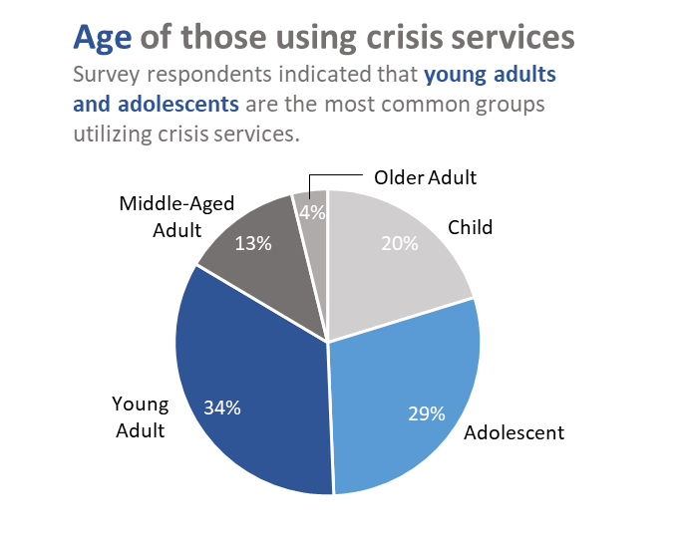
Population Data

Slide 22
Perspectives on Crisis Support

Slide 23
Crisis Responder Areas of Expertise

Slide 24
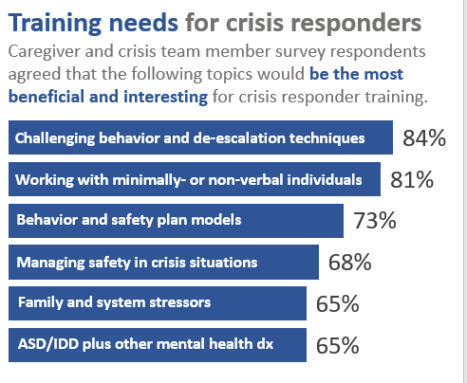
Crisis Responder Areas of Expertise

Slide 25
What is Needed?
In Home
Behavior Support

Slide 26
Understanding the Current State of Crisis Events
We consistently hear from key stakeholders that there are efforts underway or new programs being developed to address this issue
Caregivers and providers continue to stress that the issue of crisis is increasing, instead of decreasing
Caregivers and providers continue to articulate that the current services do not meet the need either in terms of:
Model
Time to intervention
Intensity
Inclusivity of those with profound autism across the age range

Slide 27
Hospital Data Analysis
Purpose: To understand the numbers of individuals with I/DD who were utilizing psychiatric emergency or inpatient services over 4 fiscal years and to evaluate
Trends (increasing, decreasing, stability)
Population information
Treatment
Other factors (such as cost) that would help us advocate for program development

Slide 28
Data Analysis: Number and Frequency
Pediatric

Slide 29
Data Analysis: Number and Frequency
Pediatric
Adult

Slide 30
Who are the children?

Slide 31
Who are the children?

Slide 32
Who are the adults?

Slide 33
Who are the adults?

Slide 34
Location of Evaluation/Treatment
Pediatric

Slide 35
Location of Evaluation/Treatment
Pediatric
Adult

Slide 36
Length of Stay & Recidivism
Pediatric

Slide 37
Length of Stay & Recidivism
Pediatric
Adult

Slide 38
What Does it All Mean?
Almost 50% of children and 20% of adults who utilize psychiatric hospital services in our system have autism
We tend to see the highest levels of utilization in the adolescent and early adult years
Children and adults come to the hospital for very different reasons
This population is rarely admitted for inpatient psychiatric treatment
Children with LOS over 50 days is increasing dramatically (Most of these individuals are boarding for a safe disposition)
Adult numbers remain somewhat consistent, with a slight decrease in LOS over the last 2 years

Slide 39
How do We Move Forward?
Create a fiscal analysis to show cost savings or cost offset to systems
Define an optimal continuum of care (i.e., prevent, triage, and support the crisis to PREVENT the emergency)
Ensure the continuum exists regionally across states
Work with state and national stakeholders to ensure funding is aligned to continuum models
Expect that any individual max need to utilize different services across the continuum at any point in their life

Slide 40
Who has assessed a continuum of care?

Slide 41
What does a comprehensive continuum consider?
Must be considerate of the environmental and developmental needs of the individuals
Must view the family as assets
Must be urgent and flexibly responsive
Able to support those who needs vary depending on:
Underlying behavioral health or neurodevelopmental vulnerabilities
Exposure to trauma and adverse childhood experiences
Exposure to adverse social determines of health
Presence of a life transition or relationship stress
Any of these needs can destabilize a family system or individual and create a crisis

Slide 42
Fragmented Crisis Care Model

Slide 43
Fall Crisis Continuum of Care

Slide 44
Team Makeup
Master’s level clinicians trained in urgent care assessment and crisis intervention
Care Coordinators
Family Partners
Registered Nurses
Psychiatrist or APP nurses
Board Certified Behavior Analysts
MD or NP
Developmental Pediatrician
Psychologists

Slide 45
What is Needed?
Integrated Care Across the Continuum
Early Intervention & Engagement Services
Outpatient
Services
Acute Intervention
Services
Residential and Inpatient
An integrated team includes medical, behavioral, mental health, care coordination, and community providers who can follow the individual along their journey regardless of where in the continuum they fall

Slide 46
In the Interim
Articulate your individual needs in clear written format
If you don’t have a safety/crisis plan create one with a provider
Share your plan with local ER and EDs
Know what to expect when calling or utilizing these services
Connect with any resources available- even if they will not meet the need
Meet with providers in your area to understand what they do/don’t offer
Partner with agencies on data analysis and advocacy
Tell your story and give us your feedback!

Slide 47
How to Advocate
Tell your story-> Clearly state what the optimal outcomes would be
Be concise, to the point, and repeat!
Support initiatives around CMS funding for stabilization/long term care opportunities
Higher reimbursement rates for complex individuals with autism
CIT training for law enforcement
Join a public advisory group or committee
Identify providers that would benefit from training on autism and crisis
Work with your Medicaid, Medicare, or commercial payers to understand what resources may be available to you and your family

Slide 48
Thank You
Amanda_Laprime@URMC.Rochester.edu Michelle.Bagby@tn.gov

