Slide 1
Hospitalization and Residential Treatment for those with Severe ASD
ARE WE STILL IN THE DARK AGES?
Karen Fessel, Dr PH
www.mhautism.org

Slide 2
In Memorium: Feda Almaliti, 1977-2020
For educating me on the challenges of severe autism and not taking no for an answer!!

Slide 3
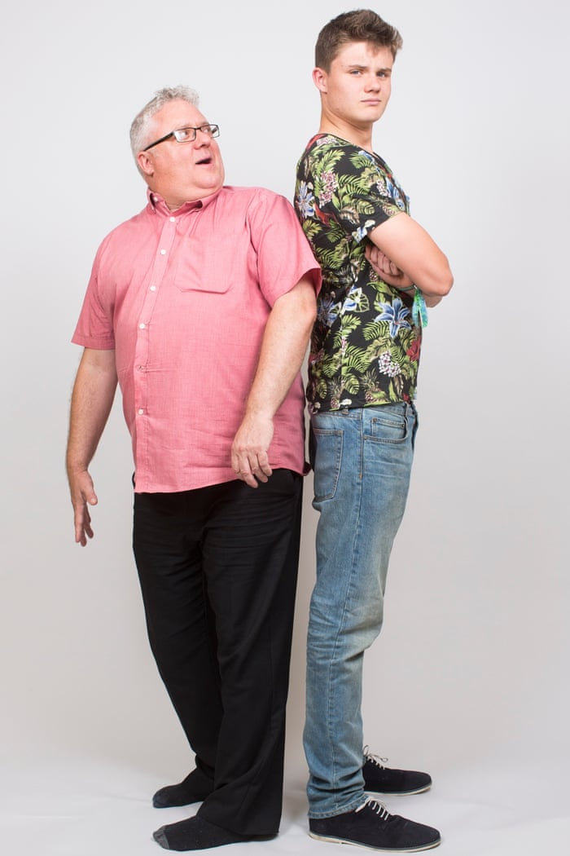
What Happens When Behaviors Become Unmanageable?
Scenario: Children with severe ASD hit adolescence.
Bigger than parents
Hormones kick in
Developmental changes

Slide 4
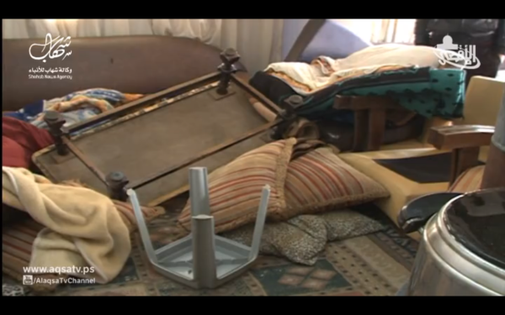
What are Unmanageable Behaviors for those with Severe Autism, 1
Danger to self and others
Elopement--Inability to be contained or confined
Repeated physical aggression
Frequent, serious self injury
Serious and persistent sleep disturbance
Property destruction
School expulsion
Pica
Severe decreases in functioning
Often unpredictable, even with FBAs

Slide 5
What are Unmanageable Behaviors for those with Severe Autism, 2
Cannot be addressed, reduced or ameliorated through behavioral treatments;
Person cannot be de-escalated.
Person poses an urgent threat that cannot be contained.
Main Choice: Call 911(or 988, coming soon, specific emergency line for mental health emergencies)

Slide 6
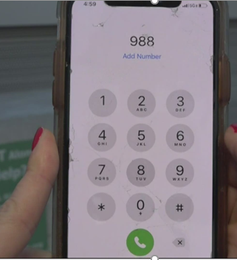
Coming soon to your community: 988
The Federal Communication Commission approved 988 as an emergency number to be used for mental health crises, including those at risk for suicide, substance use, and other issues. (S. 2661, 116th Congress)
May be used differently in different parts of the country
Effective July, 2022.
Calls are routed to local crisis centers, where trained counselors will answer and can direct crisis mobile teams trained in de-escalation to show up (instead of police).
Law requires they be equipped to provide specialized resources to high risk populations (does not specifically name those with severe ASD)
States are responsible for developing a strategy, but there may be federal or state funds included in the future.
Special populations named include LGBT youth and those at risk for suicide
Up to US to make sure they have autism expertise and are versed in severe autism.

Slide 7
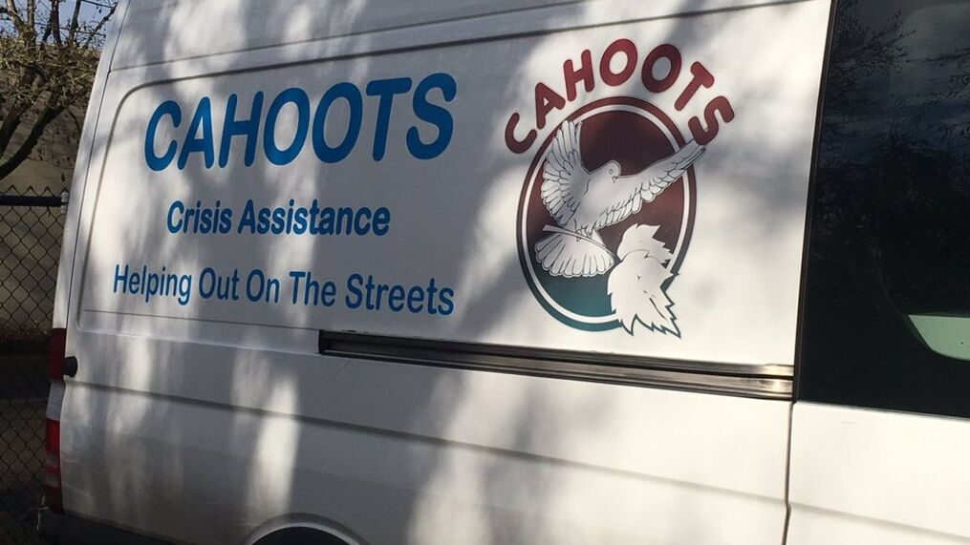
Mobile Crisis Units
Typically provide on-site assessment (may evaluate for 5150 – psychiatric hold) with safety planning for family.
Crisis management
Sometimes provide access to short-term treatments
Referral to local resources
May act as gatekeeper to inpatient hospitalizations
Some work in concert with the police (reporting requirements) and others do not.
What is available varies by locality.
It may be up to US to make sure they are skilled in severe autism. Speak up to your state representatives.

Slide 8
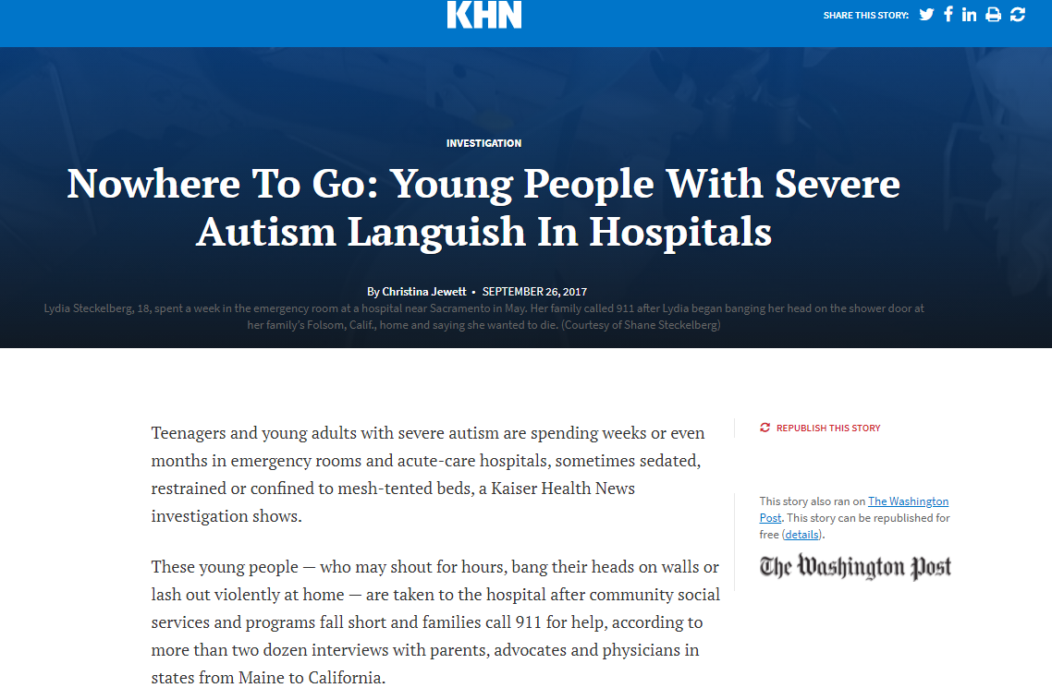
EVERY Autism Parent’s NIGHTMARE
INVre To Go: Young People With Severe Autism Languish In Hospitals
SEPTEMBER 26, 2017
One stayed nearly a year
Staff not properly trained
Some are repeatedly sedated
One had wrists and ankles strapped to ER bed for a week
Unable to stabilize or they are not safe in the general community
Some are “Warehoused” in modified rooms in the ER or on a hospital floor until a specialized facility has an open bed.

Slide 9
Innovative program in 3 major children’s hospitals
Bancroft Schools in NJ contracted with three large metropolitan hospitals to provide consultation and high level support to their clients with severe ASD (CHOP in Philly, DuPont in DE, Memorial, in NJ)
Were available on-call to ERs, provided ABA type care to those exhibiting challenging behaviors, many of whom needed medical treatment.
Advised on sensory and space issues to medical units that were treating those with severe ASD.
Worked 1-on-1 to those in the behavior units with severe autism.
For those with severe ASD needing scheduled medical procedures and hospital stays, they were able to schedule in advance, build rapport, and elicit cooperation from clients.
Reduced staff injuries, overtime, and amount of staff needed in care
Ultimately, they ended up training staff to safely and competently work with this population

Slide 10
Known Risk factors for inpatient hospitalization for those with Severe ASD
Adaptive functioning challenges
ASD symptom severity
Marital status of primary caregiver
Presence of mood disorders
Sleep problems (Righi et al, 2018)

Slide 11
Inpatient Units Specializing in Severe Autism, and Growing!!

Slide 12
Focus on Hospital for Special Care, inpatient unit in CT

Slide 13
What do they offer?
Immediate Stabilization (especially if admitted through the ER)
Comprehensive psychiatric (medication evaluation) psychological assessment, some will do functional behavior assessments, speech, OT, ABA, Special ed, nursing, social work
Development of comprehensive treatment plan
Training parents and home team to generalize skills learned
Parent resources for outpatient supports in community
May use bio-behavioral approach with ABA and targeted psychopharmacology
Longer LOS, allowing detailed observation and more practice for caregivers and child to practice techniques
Many have 25 hour week partial hospital programs for step down or hospital diversion, usually short term(4-6 weeks).

Slide 14
Benefits of specialized hospitals
When compared to those treated in mainstream psych units, those treated in specialized facilities had
Lower scores on the Abberrant Behavioral Checklist-Irritability subscale at discharge and two months post discharge.
Reduction in problem behaviors
Less likely to experience an ER visit within two months post discharge. (Taylor et al., 2019)
Likely results in significant cost savings, (and saving emotional trauma to family)

Slide 15
Potential Barriers
There simply are not enough, they are geographically clustered in the northeast and have waitlists.
Covered by most commercial private insurance, but they will try to limit LOS and put up other obstacles.
Some programs give priority to in-state residents.
In some states, will be covered by Medicaid and Medicaid waiver programs, though often limited to in-state.
If there is nothing in your state, get involved with your state representatives and developmental disabilities departments. Ultimately it is about money, priorities, and need!!
Treating our loved ones in these units ultimately saves everyone money.

Slide 16
We May Have to Make it Happen
If we build it, they will come!!
Parents, hospital professionals, autism professionals, politicians, journalists, educators and many others all made it possible.
Laws require that these types of services be available
Most appropriate as a unit in specialized children’s hospital, often affiliated with a teaching hospital.
https://www.mainehealth.org/Spring-Harbor-Hospital/Developmental-Disorders-Program
https://hfsc.org/specialties/autism-center-at-hsc/

Slide 17
Residential Treatment Options– who will pay?
Usually of much longer duration than hospitalization (30 days-2 years)
Can also be known as therapeutic boarding schools, can be dually licensed by state education and health or mental health departments.
For children, either the whole or the educational portion can be covered by the school district (varies by state).
In some states, the room and board portion can be covered by Medicaid, which sometimes provides for long term care.
For adults, some developmental disability departments will fund some portions of the programs
Some private health plans will pay for a limited duration of the needed stay.

Slide 18
Residential Treatment – Private Insurance?
Most plans do not have facilities for severe autism in-network. Request a single case agreement or gap exception to use in-network benefits.
Make friends with your care manager, they can be the gatekeepers.
To get insurance to pay for treatment usually requires a process of ongoing utilization review. This requires the facility to call in to the health plan on a regular basis (often every week), providing an update, and justifying the need for continued care. This typically last 30-60 days.
Once care is denied, we prepare an appeal and sometimes request an external review with an “independent” review agency. If unsuccessful, we will refer to an insurance attorney.
Requires paying out of pocket while attorney works the case (can take many months to get a settlement, and much longer if you go to court).
Some plans are harder to work with than others. Most want to get you out within a few weeks.

Slide 19
Residential Treatment – Private Insurance
Federal and state parity laws have amazing potential, getting plans to provide needed treatments, but it is not happening in the ways we need.
We need better laws which incorporate principles from Witt case, and more aggressive regulation on both the state and federal level to make this a reality.
CA recently passed model parity legislation, incorporating some of ideas from the Witt case.
Early to know how it will be enforced
Ironically, if you can fine health plans for failing to follow the law, it will more than pay the salaries of those enforcing it.

Slide 20
Residential Treatment – School District
Keep your child in district through age 22, if they qualify
Keep communication lines open with your school district. It is best to provide advance notice in writing before enrolling your child in a non-public school.
IDEA requires that the district provide a free and APPROPRIATE public education. Many districts do not have an appropriate program that can safely and effectively treat children with severe autism. They are mandated to provide an appropriate program and must look outside of the district and even outside the state if nothing is available.
You will likely need a SPED attorney to help you get this type of placement:
http://connect.copaa.org/network/find-a-professional
Council of Parent Attorneys and Advocates has a list of attorneys and professionals by state.
Some states have few SPED attorneys, little case law, and untrained judges. Can be a barrier in some parts of the country.

Slide 21
Residential Treatment Programs
Often live in secure home-like buildings with group of similar peers, private bedrooms, teaching kitchens that allow teaching of food preparation, multi-sensory rooms for relaxation, outdoor playgrounds, and technology.
May have levels/tiers based on level of functioning
Highly structured day school programs and afternoon activities, and also individualized.
Weekends participate in recreational activities, chores, may go into the community
Parents may be involved in weekly family virtual sessions, and may have near monthly visits.
Students have individualized behavioral plans. Treatment plans are continuously updated. Includes medication management and monitoring.
Transition gradually to lower care and support levels, home “trial” visits.

Slide 22
So, Are we Still in the Dark Ages?
Yes, because:
There are not nearly enough of programs to serve those who need them
We still have to fight to get them paid for.
We still need better enforcement of mental health and autism laws and IDEA.
We still have to get involved, speak up to legislators, speak to the press, raise awareness, raise money, advocate, and make it happen.
But now at least we are starting to see solutions and innovative programs. There is more awareness, and a little more light.

Slide 23
Partial List of Inpatient Facilities (children)
Children’s Hospital Colorado, Neuropsychiatric Special Care Program
Uses ABA, CBT, and TEACH methods, short term stabilization
Kennedy Krieger Institute Neurobehavioral Unit
16 bed
3-6 month LOS, tend to keep clients longer
Cincinnati Children’s Hospital
2-7 days, acute stabilization, then uses a mental health continuum which can include a 30 plus day stay in residential treatment
Streamwood Behavioral HealthCare System, Behavior Intervention Unit, uses ABA, focusses on stabilization. (Oakbrook Ter, IL)

Slide 24
Partial List of Inpatient Facilities (children)
Bradley Hospital, Center for Autism and Development Disabilities, Providence, RI
19 bed unit
Uses Positive Behavior Supports
Average LOS 28 days
Spring Harbor Hospital, Autism and Developmental Disorders Services, Westbrook, Maine
12 bed Unit
ABA approach,
30-40 day LOS
Hospital for Special Care, Autism Inpatient Care, New Britain, CT
12 bed unit
ABA based
Recently added 4 beds from $6,000,000 grant from state
Ages 10-21, priority given to CT residents
30 day stay

Slide 25
Partial List of Inpatient Facilities (Adults)
Western Psychiatric Institute and Clinics, Center for Autism and Developmental Disorders, Pittsburgh, PA
Acute stabilization with specialized evaluation and treatment

Slide 26
Residential treatment facilities for those with Severe ASD
Monarch Center for Autism (OH)
Bancroft School, The Lindens (NJ)
Lake Mary’s Center (Missouri)
Heartspring (Kansas)
Shrug Oak (NY)
King’s Daughter (TN)
Anderson School for Autism (NY)
Gersh Academy (NY, NJ)
Devereux Centers (some are through the lifespan, some are schools):
AZ, CA, CO, CT, DE, FL, GA, MA, NJ, NY, PA, TX

Slide 27
Residential treatment facilities for those with Level 1 ASD(may have some severe behaviors)
Daniels Academy, Utah (boys)
New Focus Academy, Utah (boys)
Seven Stars (Hybrid Wilderness Program), Utah
Maple Lake Academy (Girls only), Utah
Maple Lake Academy for Boys, Utah
Heritage Community, Utah (Young adult programs as well)
Aspiro Vantage Point Program, (Wilderness), Utah
Waterfall Canyon Academy (Utah) (Young Adult programs as well)

Slide 28
Landmark Class Action: Wit vs United Healthcare
Court required that health plans consider the following 8 pillars in determining medical necessity:
Mental health disorders are chronic, with acute manifestations. Effective treatment includes treating the underlying conditions, not just stabilization
Comorbidity is common, effective treatment requires a coordinated approach
Factors driving level of needed care are safety and effectiveness.
If there is any doubt, place at the highest level of care that is both safe and effective. Undertreating can be harmful
Effective treatment involves improvement in functioning, also includes preventing regressions and maintaining current functional level.
Duration is based on individual need, not set amount of time.
Children and teens are not fully developed and thus require individualization and relaxing threshold requirements for admission and continued care
Level of care decisions should be based on multiple dimensions.

